Slide 2
HIV-1 drug resistance and third-line outcomes among children and adolescents failing second-line therapy in Malawi
Rachel Kamba
@TwitterHandle
Share your thoughts on this presentation with #IAS2019

Slide 3
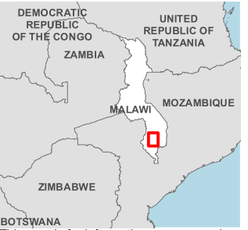

HIV-1 drug resistance and third-line outcomes among children and adolescents failing second-line therapy in Malawi
Rising resistance to first-line line drugs
More patients on second-line line
  Higher level of treatment failure
  Genotype to confirm treatment failure not routinely available
  Limited information on outcomes of children and adolescents on 3rd line
Chiradzulu, Malawi in 2019
  Pop: 336,000
  34,000 patients on ART
  10% on 2nd line (45% <20yo)
  Virological Failure on 2nd line
    Adults: 8% (15% in 2016)
    Children/Adolescents: 16% (25% in 2016)
Image Source: Gupta RK, Lancet Infect Dis 2017;18: 346–55

Slide 4
Results
Resistance Profiles
Viral Load Outcomes
Resistant to at least one NRTI
75 (76%)
Resistant to at least one PI
28 (28%)
Resistant to all available NRTIs
14 (14%)
Not resistant to any PI or NRTI
24 (24%)
Resistant to at least one PI and all available NRTIs
12 (12%)
NRTI: Nucleoside Reverse Transcriptase Inhibitors
NNRTI: Non-Nucleoside Reverse Transcriptase Inhibitors
PI: Protease Inhibitor
INSTI: Integrase Strand Transfer Inhibitor
Not all patients had completed 6 or 12 months after being switched to 3rd line or after genotype for patients remaining on 2nd line at this time
Overall, 33 patients (33%) were switched to 3rd line

Slide 5
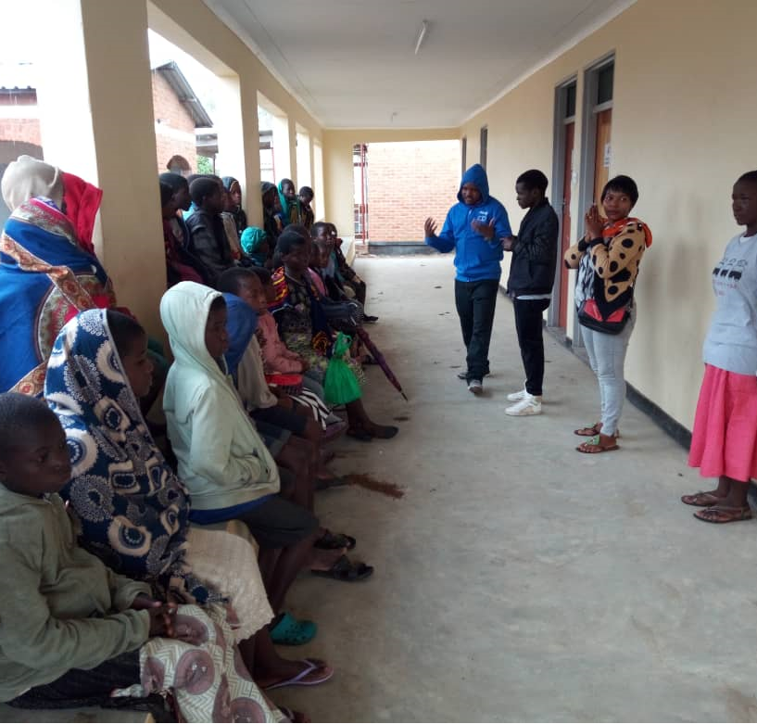
Discussion
Over 30% of children and adolescents failing second-line required third-line initiation
  Genotyping needed to identify ARV resistance
High level of virological suppression on third-line
  Similar outcomes to a recently reported multi-country trial (ACTG 5288)
  Access to 3rd line drugs for children difficult and expensive
Poor outcomes among those who remain on second-line
  Development of Complex Case Management Team
Limitations
  Genotyping only done for patients with confirmed treatment failure (some died or lost to follow-up before genotype)
  Non-experimental study design
  Small numbers

Slide 6
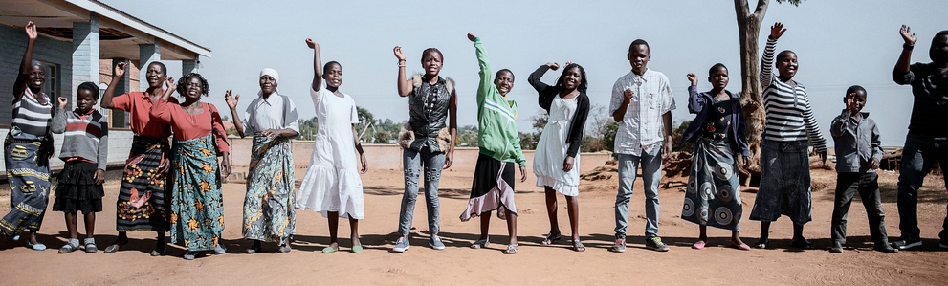
Acknowledgments
We would like to thank all participants, field workers, and MSF field teams for their support and contribution to this study.
The authors have no conflicts of interest to disclose

